Slide 1

YSC2239 Lecture 9

Slide 2
Recap
Steps for statistical tests of hypotheses
Null hypothesis and Alternative hypothesis
The test statistic and observed value of the test statistic
Distribution of test statistic by simulation under null hypothesis
Conclusion: reject or not reject (using p-value)
p-value: the probability of the observed value or even more extreme results if null hypothesis is true. (in short: p-value if the probability of null hypothesis being true.
Significant level (also called alpha level)

Slide 3
Today’s class
A/B Testing
Confidence Intervals
Reading: Chapter 12 and 13

Slide 4
A/B Testing

Slide 5
Comparing Two Samples
Compare values of sampled individuals in Group A with values of sampled individuals in Group B.
Question: Do the two sets of values come from the same underlying distribution?
Answering this question by performing a statistical test is called A/B testing.
(Demo)

Slide 6
The Groups and the Question
Random sample of mothers of newborns. Compare:
(A) Birth weights of babies of mothers who smoked during pregnancy
(B) Birth weights of babies of mothers who didn’t smoke
Question: Could the difference be due to chance alone?

Slide 7
Hypotheses
Null:
In the population, the distributions of the birth weights of the babies in the two groups are the same. (They are different in the sample just due to chance.)
Alternative:
In the population, the babies of the mothers who smoked weighed less, on average, than the babies of the non-smokers.

Slide 8
Test Statistic
Group A: smokers
Group B: non-smokers
Statistic: Difference between average weights
Group A average - Group B average
Smaller values of this statistic favor the alternative

Slide 9
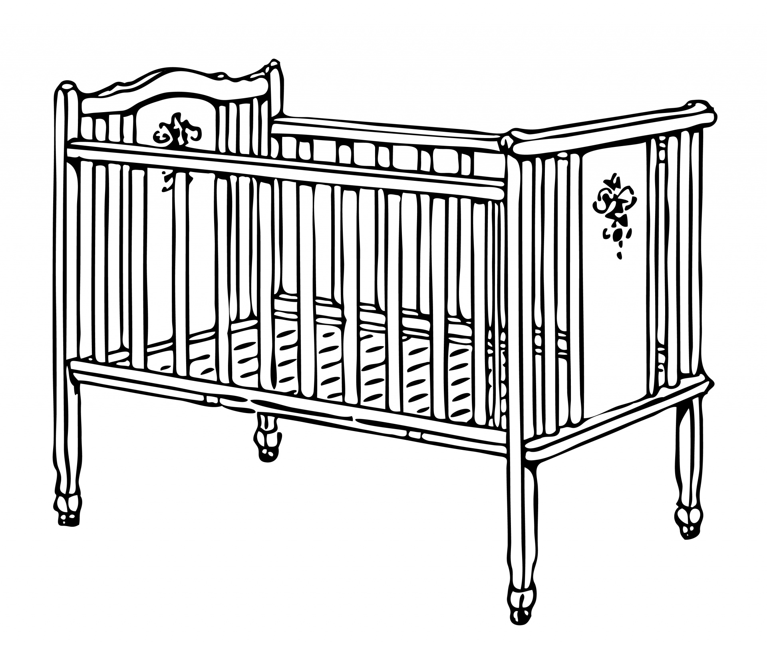
Simulating Under the Null
...
Non-smoker
Non-smoker
Smoker
Non-smoker
Smoker
120 oz
113 oz
128 oz
136 oz
108 oz

Slide 10
Simulating Under the Null
...
Smoker
Non-smoker
Non-smoker
Smoker
Non-smoker
120 oz
113 oz
128 oz
136 oz
108 oz

Slide 11
Shuffling Rows

Slide 12
Random Permutation
tbl.sample(n)
Table of n rows picked randomly with replacement
tbl.sample()
Table with same number of rows as original tbl, picked randomly with replacement
tbl.sample(n, with_replacement = False)
Table of n rows picked randomly without replacement
tbl.sample(with_replacement = False)
All rows of tbl, in random order
This is what we’ll use for A/B testing
(Demo)

Slide 13
Simulating Under the Null
If the null is true, all rearrangements of labels are equally likely
Plan:
Shuffle all group labels
Assign each shuffled label to a birth weight
Find the difference between the averages of the two shuffled groups
Repeat
(Demo)

Slide 14
A/B Tests are Hypothesis Tests
Determine the 2 models (Null Hypothesis and Alternative Hypothesis)
Ex. Null hypothesis: In the population, the distributions of the birth weights of the babies in the two groups are the same.
Determine a test statistic that gives evidence for the alternative model
Test statistic is often (but not always) the difference or absolute difference between group means
Simulate the test statistic under the null hypothesis many times and store those values in an array
Simulated by shuffling the labels column of the table
Compare the observed test statistic and its empirical distribution under the null hypothesis
Draw a conclusion comparing the p-value to the p-value cutoff

Slide 15
Percentiles

Slide 16
Computing Percentiles
Sort the numerical set in increasing order. The 80th percentile is first value on the sorted list that is at least as large as 80% of the elements in the set
For s = [1, 7, 3, 9, 5], percentile(80, s) is 7
The 80th percentile is ordered element 4: (80/100) * 5
Percentile
For a percentile that does not exactly correspond to an element, take the next greater element instead

Slide 17
The percentile Function
The pth percentile is the value in a set that is at least as large as p% of the elements in the set
Function in the datascience module:
percentile(p, values)
p is between 0 and 100
Returns the pth percentile of the array

Slide 18
Discussion Question
Which are True, when s = [1, 7, 3, 9, 5]?
percentile(10, s) == 0
percentile(39, s) == percentile(40, s)
percentile(40, s) == percentile(41, s)
percentile(50, s) == 5
(Demo)

Slide 19
Estimation

Slide 20
Inference: Estimation
How big is an unknown parameter?
If you have a census (that is, the whole population):
Just calculate the parameter and you’re done
If you don’t have a census:
Take a random sample from the population
Use a statistic as an estimate of the parameter
(Demo)

Slide 21
Variability of the Estimate
One sample ➜ One estimate
But the random sample could have come out differently
And so the estimate could have been different
Main question:
How different could the estimate have been?
The variability of the estimate tells us something about how accurate the estimate is: estimate = parameter + error

Slide 22
Where to Get Another Sample?
One sample ➜ One estimate
To get many values of the estimate, we needed many random samples
Can’t go back and sample again from the population:
No time, no money
Stuck?

Slide 23
The Bootstrap

Slide 24
The Bootstrap
A technique for simulating repeated random sampling
All that we have is the original sample
… which is large and random
Therefore, it probably resembles the population
So we sample at random from the original sample!

Slide 25
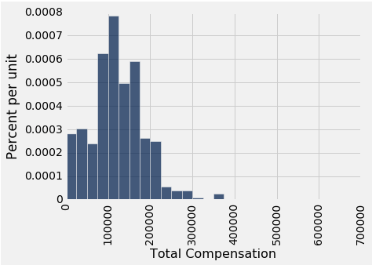
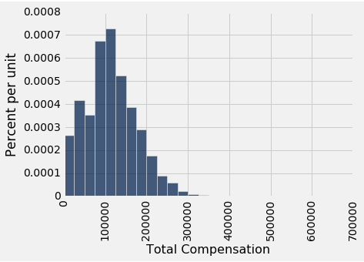
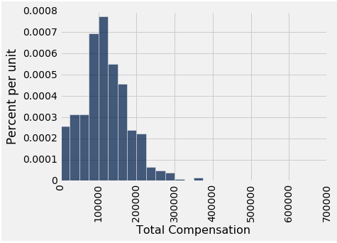
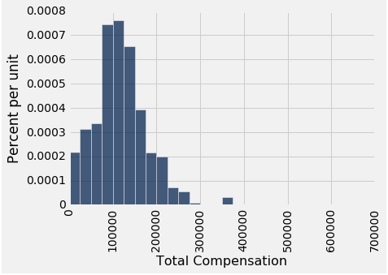
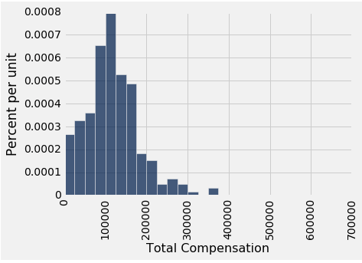
Why the Bootstrap Works
population
sample
resamples
All of these look pretty similar, most likely.

Slide 26
Why We Need the Bootstrap
population
sample
resamples
What we wish we could get
What we really get

Slide 27
Key to Resampling
From the original sample,
draw at random
with replacement
as many values as the original sample contained
The size of the new sample has to be the same as the original one, so that the two estimates are comparable
(Demo)

Slide 28
95% Confidence Interval
Interval of estimates of a parameter
Based on random sampling
95% is called the confidence level
Could be any percent between 0 and 100
Higher level means wider intervals
The confidence is in the process that generated the interval:
It generates a “good” interval about 95% of the time.
(Demo)

Slide 29
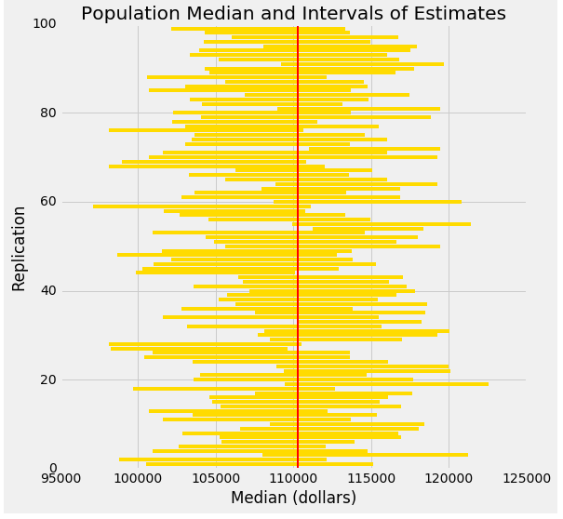
Each line here is a confidence interval from a fresh sample from the population

Slide 30
Use Methods Appropriately

Slide 31
Can You Use a CI Like This?
By our calculation, an approximate 95% confidence interval for the average age of the mothers in the population is (26.9, 27.6) years.
True or False:
About 95% of the mothers in the population were between 26.9 years and 27.6 years old.
Answer: False. We’re estimating that their average age is in this interval.

Slide 32
Is This What a CI Means?
An approximate 95% confidence interval for the average age of the mothers in the population is (26.9, 27.6) years.
True or False:
There is a 0.95 probability that the average age of mothers in the population is in the range 26.9 to 27.6 years.
Answer: False. The average age of the mothers in the population is unknown but it’s a constant. It’s not random. No chances involved.

Slide 33
When Not to Use The Bootstrap
If you’re trying to estimate very high or very low percentiles, or min and max
If you’re trying to estimate any parameter that’s greatly affected by rare elements of the population
If the probability distribution of your statistic is not roughly bell shaped (the shape of the empirical distribution will be a clue)
If the original sample is very small
(Demo)

Slide 34
To-do
Assignment 4

